Slide 1

Recursion
By Georgi Stoimenov

Slide 2


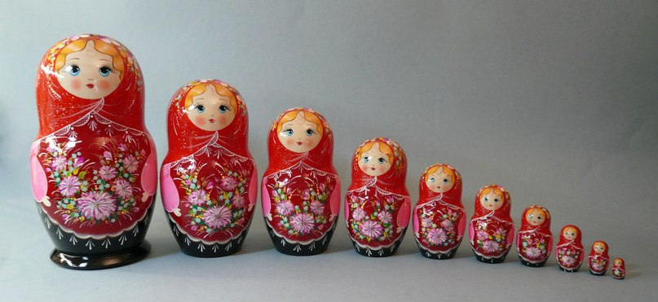
What is actually a recursion?

Slide 3

Recursion in programming is…
“Recursion is a method where the solution to a problem depends on solutions to smaller instances of the same problem (as opposed to iteration)”
Wikipedia

Slide 4

The Fibonacci sequence - Demo
Click me!

Slide 5

How it works?
Fib(4)
Fib(3)
Fib(2)
Fib(2)
Fib(1)
Fib(0)
Fib(1)
Fib(0)

Slide 6



Specifics of the recursion
Bottom
Depth
Directions

Slide 7

Modified Fibonacci
private static long GetModifiedFibonacci(int n)
{
if (n <= 2)
{
return 1;
}
long result = 5;
result += GetModifiedFibonacci(n - 1) + GetModifiedFibonacci(n - 2);
result = result * n;
return result;
}
Straight move
Bottom
Backward move

Slide 8

Recursion types
Indirect
Direct

Slide 9

Recursive algorithms
A common computer programming tactic is to divide a problem into sub-problems of the same type as the original, solve those sub-problems, and combine the results.

Slide 10
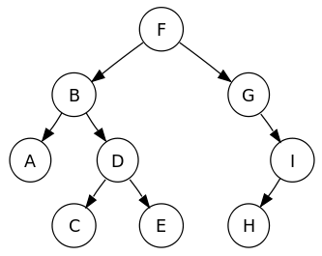
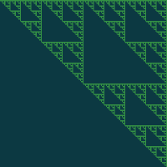

Interesting algorithms with recursion
Find path in labyrinth
Tree traversal
Click me!

Slide 11

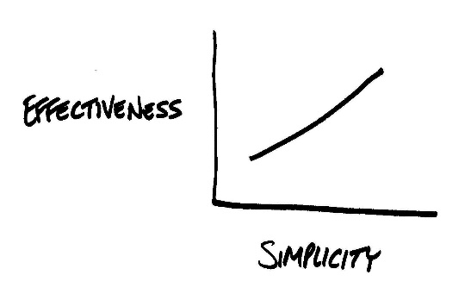
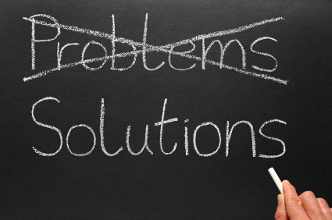
What is the idea behind Recursion?

Slide 12

Is recursion always applicable?
When using big data or even bad algorithm
can cause StackOverflow Exception.
May require more memory (because of stack).
It's usually slower due to the overhead of maintaining the stack.

Slide 13
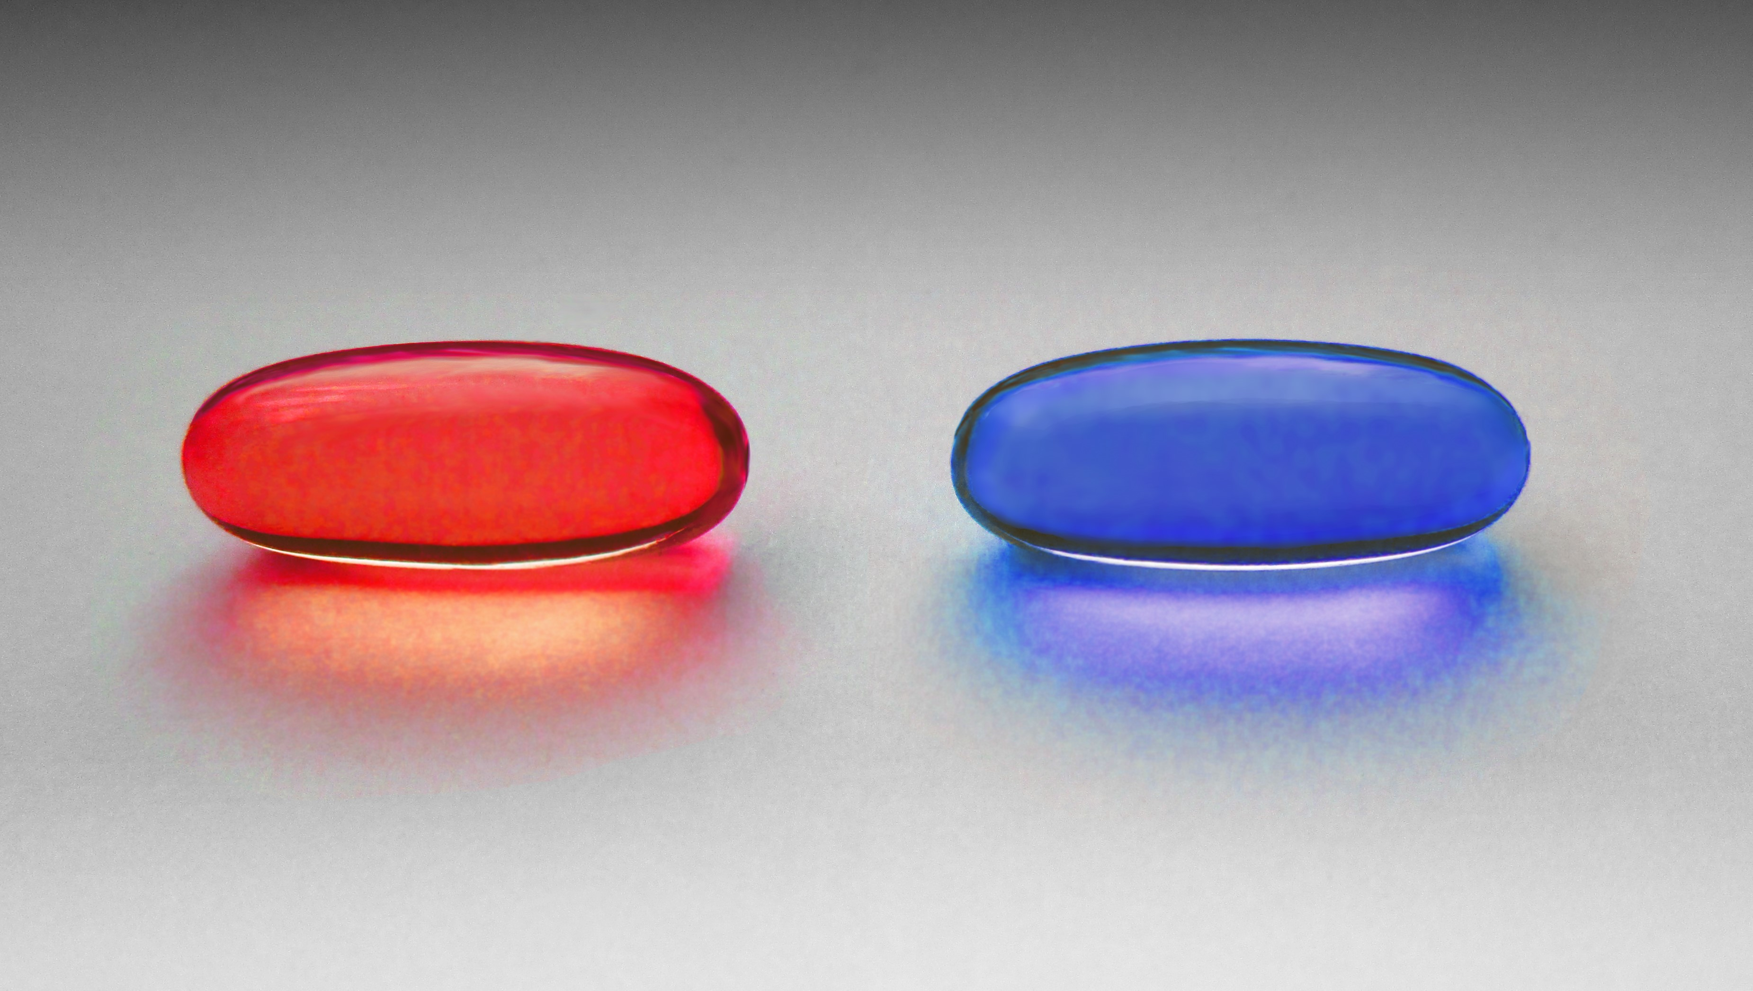



What is the alternative?
Iteration
Works well with big data.
No additional memory used.
Easy calculation of time complexity of the algorithm.

Slide 14

Conclusion
Using recursion makes
your code simple and
understandable. It can
be used to solve
difficult tasks with
ease.
However stepping
out the boundary
can make your
algorithm slow and
uneffective.

Slide 15

Thanks for the attention!
https://goo.gl/FC5hwg

